Slide 1
Navigator Reimagining the Service Forms Library Experience
adVenture Team
Eileen Hengel OBIO, Peter Mascarnhas-NYL Ventures, Baki Mumkaya- NYL Venture, Ben Saphier- NYL Ventures

Slide 2

Joe Customer
Age 55
Married with three kids 23, 21 and 19
Whole Life policy owner for over 10 years
Recently became a grandfather
Looking to update his beneficiary
Last transaction was 2012 to change address
Notes:
The typical NYL policyholder interacts with NYL only 5-6 times during the entire life of the policy, and their user experience will be quite different. The typical user would mostly search for NYL on line and land on NYL.com.
Why this use case
Low adoption rate of VSC
Limited policyowner interactions with large span of time between transactions
Only 4% of transactions performed on VSC
Service Library forms are not designed as Smart forms and without digital signature capability
Service Library primarily used to find forms to be printed
This Use Case accounts for 80% of our policyholders. If we can save just 10% of CSR calls is approx. $200K a year.

Slide 3
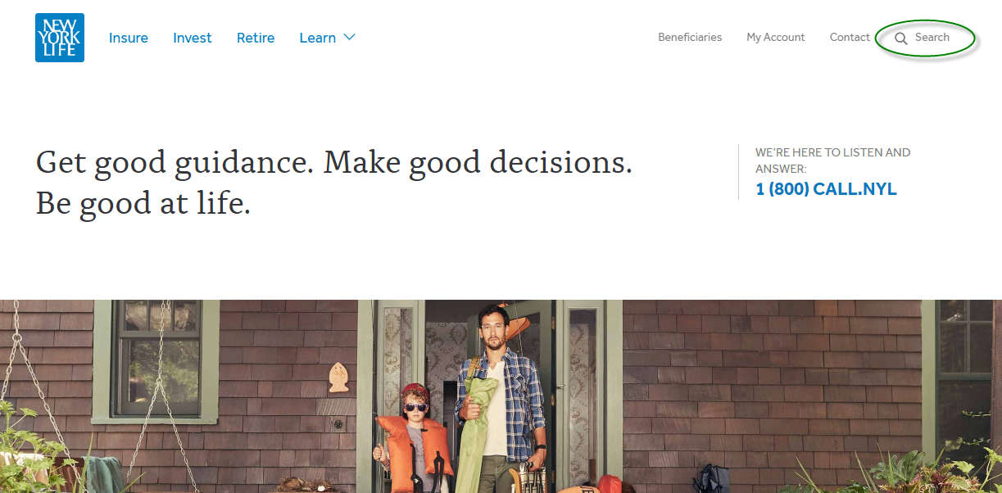
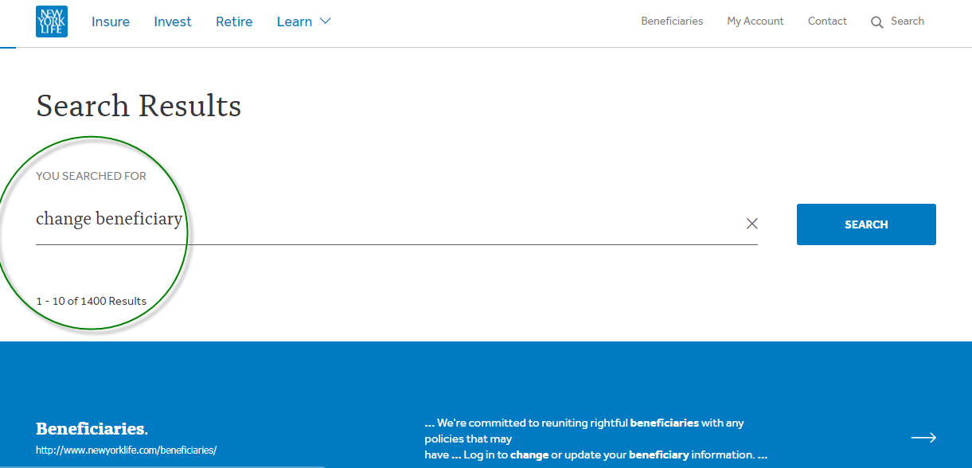
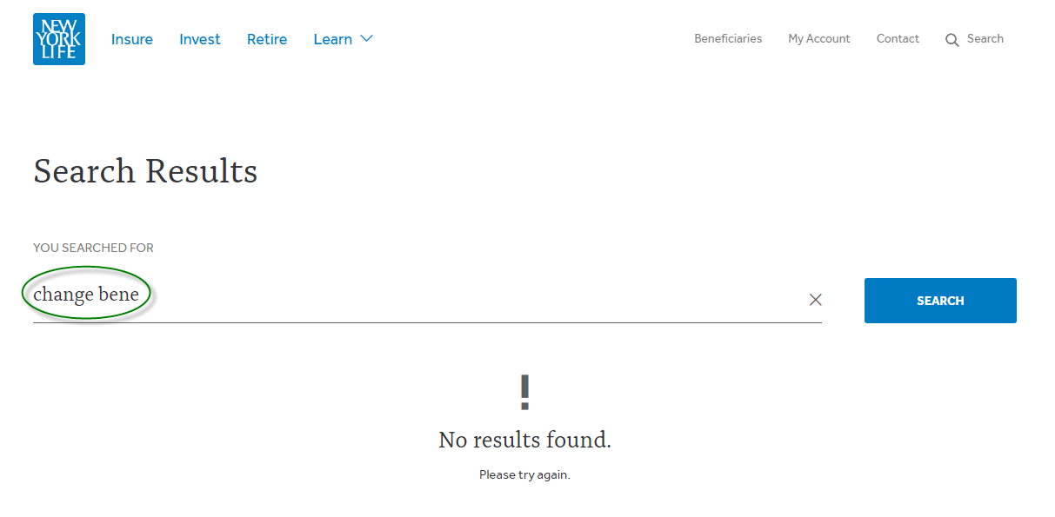
Joe, logs on NYL.com to find a beneficiary form
Notes:
From the Home Page on NYL.com the policyowner is presented with a few options on the top right:
Beneficiaries
My Account
Contact
And Search
As an infrequent user they may select Search and type Change Bene – and be returned no results or Change Beneficiaries and be returned 1,400 results, neither that would be helpful.
So what would they do next? Call
Calls cost money approx. $1 a minute and we receive nearly 2 million calls a year
So whenever we can save a call we save money

Slide 4
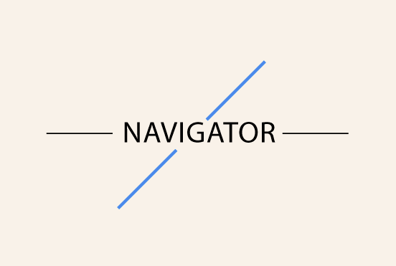
Welcome to:
Notes:
So let’s show you our solution The Navigator

Slide 5
Additional Features:
Use Google Location to prefill address change forms
Store forms completed on line in database and bar coded tag

Slide 6
Questions

Slide 7
Appendix

Slide 8
Who Accesses Forms Library?
Agent
Policy Owner
CSR
80% of Policyholders
VSC User
(id & uses)
Other
Service Forms
Notes:
Why this use case
Low adoption rate of VSC
Limited policyowner interactions with large span of time between transactions
Only 4% of transactions performed on VSC
Service Library forms are not designed as Smart forms and without digital signature capability
Service Library primarily used to find forms to be printed
This Use Case accounts for 80% of our policyholders. If we can save just 10% of CSR calls is approx. $200K a year.

Slide 9
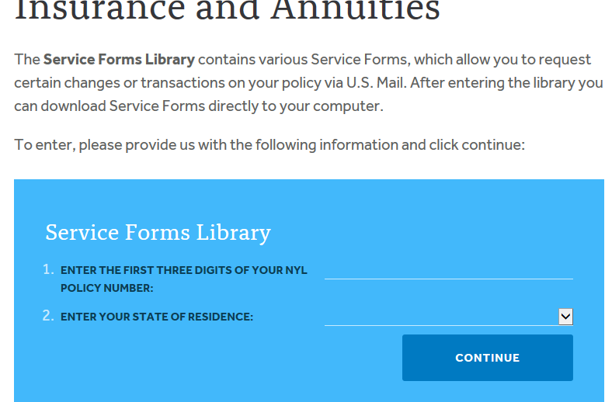
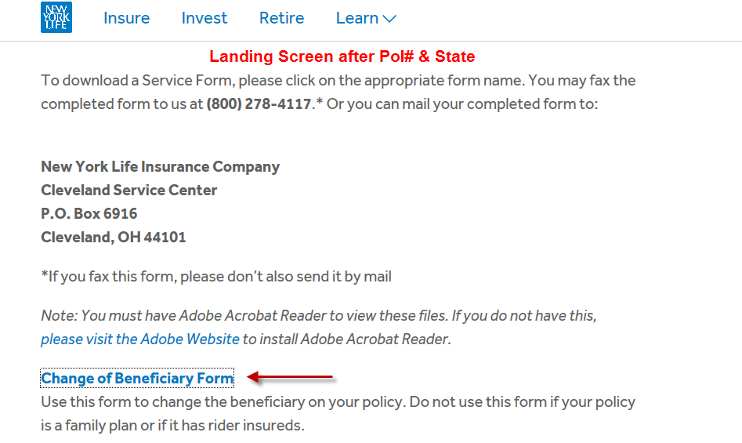
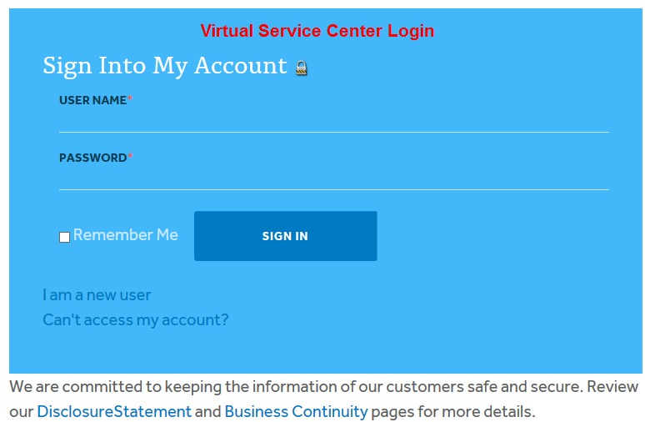
Current Flow

Slide 10
Data
Approx 5 million policy holders- 6,113,423
Only 951,750 unique users in 2016 (20%)
168,897 transactions from mobile device
Only 4% of transactions are completed on VSC
Phone calls received- 1,911,582 (2016)
VSC adoption rate 25-30% for bene, 15-20% for address change, COM- 8%
25% NIGO rate on forms either wrong or incomplete
Less then 5 interactions with NYL over the life of a policy owner (excluding agent)
Avg CSR cost per minute 75 cents to $1.00 (2014)

Slide 11
Who’s our Typical Customer
What do all these have in common?
The World Cup
The Winter Olympics
Leap year
Presidential election
The US census
Notes:
All these events occur more often than our Policyowners interact with us on their policies

